Slide 1
MS ACCESS
Group Members:

Slide 2
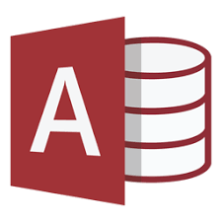
INTRODUCTION:
Microsoft Access is a popular RDMS (Relational Database Management System) which comes in MS-suite.
It is a type of database software that is used to store information for reporting, referencing and analysis.
With Microsoft Access, you can analyse large amounts of data faster and more efficiently than with Excel or other types of spread sheets.

Slide 3

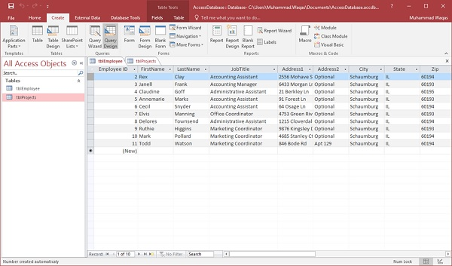
MS-ACCESS AND ITS COMPONENTS
TABLES
QUERIES

Slide 4
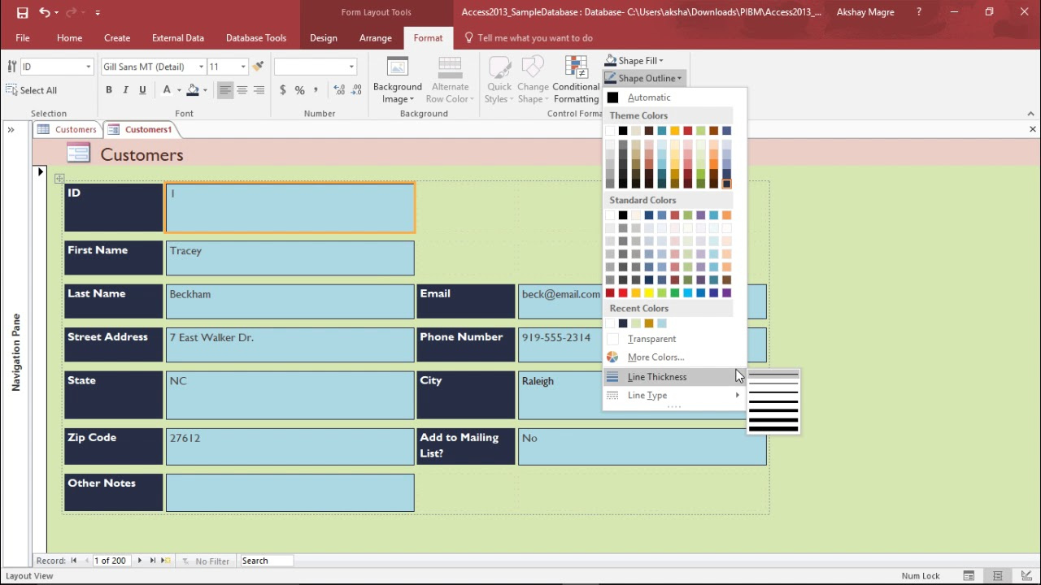
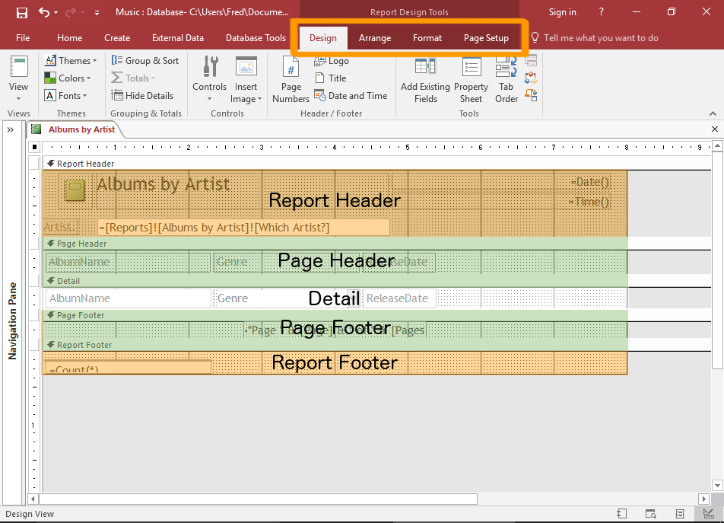
FORMS
REPORTS

Slide 5
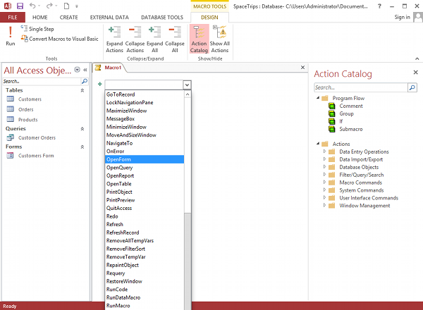
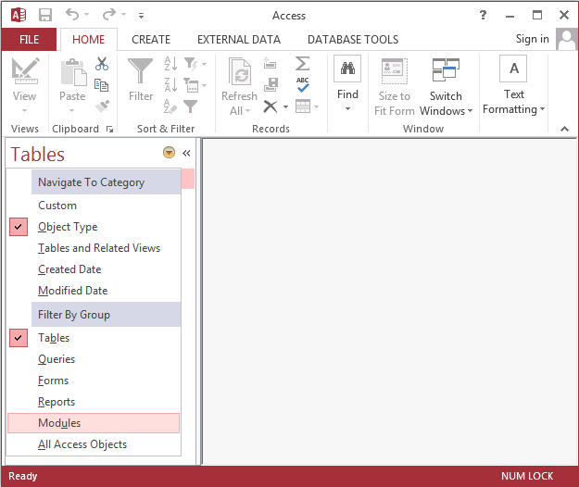
MACROS
MODULES

Slide 6
Some features of previous versions of MS-ACCESS
Make a local table from a linked table
Exporting and linking to Access data from Windows SharePoint Services
Autocorrect options
Back up a database or project
Error checking in forms and reports
Themes
Reporting with Conditional Formatting
Calculated data type
Live Preview
Backstage view
Contextual tabs
Access keys
Template databases

Slide 7
WHAT'S NEW IN ACCESS 2019?
Visualise data with new charts:
Column Charts
Line Charts
Bar Charts
Pie Charts
Combo Charts
Large Number (bigint) Support
Support for dBASE is back
Property Sheet Sorting
New Label Name property for controls
Tell Me box improvements

Slide 8
WHY MS-ACCESS?
Access has all the basic features necessary and is relatively easier to use than other databases.
It is one thing that makes Access attractive to individuals and small business is that a relatively non-technical person can whip up a database in no time using Access.
So such individuals can create an Access database themselves without any outside help. They can do this to keep track of projects, or for inventory or bookkeeping purposes, etc. If they had to use some other database, they would have to pay someone else to build the application or it won’t come up to their requirement.

